Slide 1
Deutsch-Jozsa Algorithm Revisited

Slide 2
Recap: The Deutsch-Jozsa Problem
The Deutch-Jozsa Algorithm is a generalization of the Deutscher algorithm to n-bit functions
The main problem is to check if a given multi-bit function is constant or balanced
The function is constant if it maps all inputs to the same value
The function is balanced if half of its outputs are zero

Slide 3
The Problem
able 9-1: Four possible oracles
x | f₀(x) | f₁(x) | f₂(x) | f₃(x)
000 | 0 | 1 | 0 | 1
001 | 0 | 1 | 0 | 1
010 | 0 | 1 | 0 | 0
011 | 0 | 1 | 0 | 1
100 | 0 | 1 | 1 | 0
101 | 0 | 1 | 1 | 0
110 | 0 | 1 | 1 | 0
111 | 0 | 1 | 1 | 1

Slide 4
Initial Characterization of the Circuit
Create a superposition of all 2^{n} possible inputs and evaluate them all at once with quantum parallelism (one shot).
Then we’ll use interference to process the results.
If the function is constant and the outputs are all the same, the outputs will interfere so that the measured output will be all 0s.
But if the function is balanced, the oracle’s outputs will interfere so that the measured output will be something other than all 0s (we don’t need to characterize that output any more precisely, since the conditions “all 0s” and “not all 0s” are all we need to distinguish the two possible classes).
an all bitstring of n bits of value 0 will be referred as 0^{n}, and similarly write a bitstring of all 1 is referred to as 1^{n} for a bitstring of n bits that are all 1.
The resulting high level design of the circuit is shown in the second slide

Slide 5
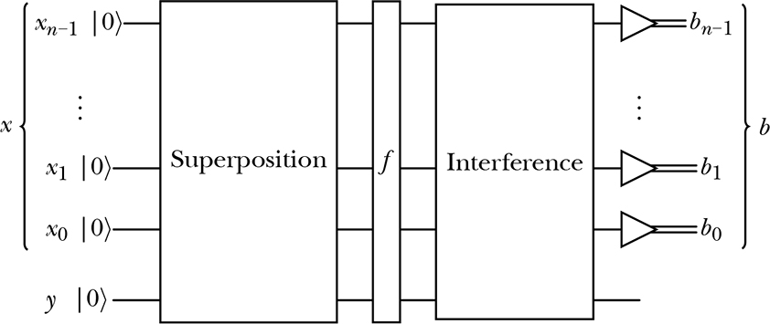
Initial High Level Design of the Circuit

Slide 6
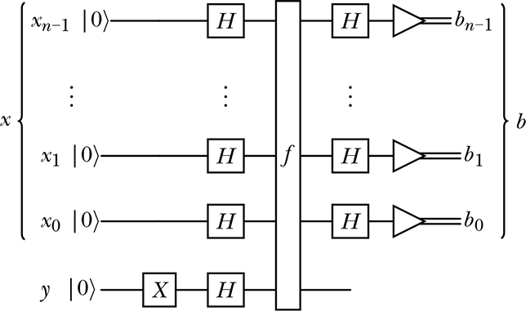
The Detailed Algorithm Circuit

Slide 7
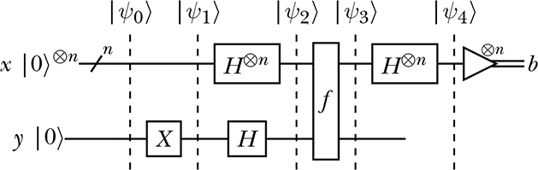
A More Compact Reprsentation of the Circuit
The figure below is more compact representation of the algorithm
In this figure all x qubits are collectively drawn on a single row, applying the exponent tensor product n to each gate to stand for n gates.

Slide 8
Comments on the above Diagram
There are two new conventions in the above diagram (previous slide):
First, to represent a bundle of qubits we use a single wire but place a slash on it, along with the number of wires (or qubits) in the bundle.
Here, the upper-left horizontal line represents a bundle of n qubits. This declaration continues for that wire through the rest of the circuit, unless it’s explicitly changed.
Therefore, in the above diagram, the upper line coming out of f still represents a bundle of n qubits. That bundle then goes into a bundle of n meters. The collective output of the meters is a bitstring of n classical bits.
Treating multiple qubits as a group in this way often makes the diagrams simpler and easier to interpret. We call each such bundle of qubits a register.

Slide 9
Comments on the Above Diagram
The second new notation is the ⊗n exponent. This indicates that a state, gate, or meter is tensored with itself n times.
For example, we can write |0⟩^{⊗3} = |0⟩ ⊗ |0⟩ ⊗ |0⟩ = |000⟩, and H^{⊗3} = H ⊗ H ⊗ H. Similarly, a meter with ⊗3 above and to its right represents a stack of three meters, applied to each of three qubits.
In this case, the input |0⟩^{⊗n} tells us that x is a system created by multiplying together n qubits, each in state |0⟩. This bundle is then run through H^{⊗n}, a vertical system of gates composed of n copies of H stacked up and multiplied together.
They all go through f, along with y. The qubits of x are then fed into another system of n copies of H, and then each qubit is measured independently, creating the n-bit output bitstring b.

Slide 10
First Step

Slide 11
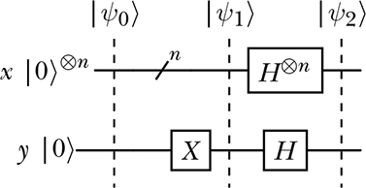
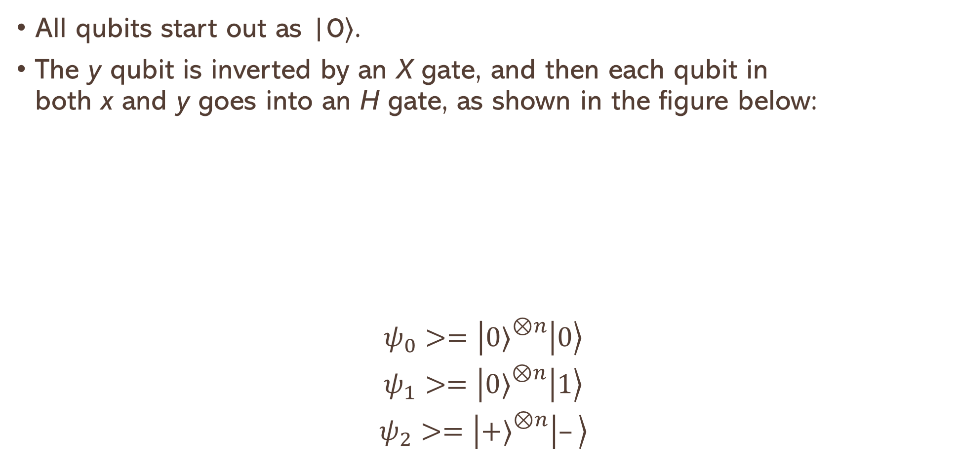
Step 1 Part 1: Before the Oracle
All qubits start out as |0⟩.
The y qubit is inverted by an X gate, and then each qubit in both x and y goes into an H gate, as shown in the figure below:
$$\begin{matrix}\left.ψ_{0}>=\left|0{\left.⟩\right.}^{⊗n}\right|0\right\rangle \\ \left.ψ_{1}>=\left|0{\left.⟩\right.}^{⊗n}\right|1\right\rangle \\ \left.ψ_{2}>=\left|+{\left.⟩\right.}^{⊗n}\right|–\right\rangle \end{matrix}$$

Slide 12
Step 1: part 1: Before the Oracle
Note that H |0⟩ = ∨ |0⟩ + ∨ |1⟩
V =1/√2
|+⟩ = zero initial state superposition ∨ |0⟩ + ∨ |1⟩
|-⟩ = one initial state superposition ∨ |0⟩ -∨ |1⟩

Slide 13
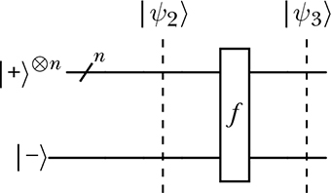
Step 2: Querying the Oracle
Now that we have placed x have been placed into an equal superposition of all possible inputs for n qubits, and y have been placed into |–⟩, we’re ready to give those inputs to the oracle. The diagram for this operation is shown below

Slide 14
The Oracle Role
As hinted before , and based on quantum superposition parallelism, the oracle will process each of the states in the superposition |ψ₂⟩ at the same time and produce a new superposition |ψ₃⟩ as output.
Each state in the output superposition is the result of querying the oracle with the corresponding state in the input superposition.
The result of applying The oracle, in one step, acts in parallel on every possible input of n qubits to produce a new superposition that contains the output of every input qubit.
Each such output has the same form: the input state |k⟩ multiplied with the y input |–⟩, multiplied by either 1 or –1, depending on the oracle’s response to that input.

Slide 15
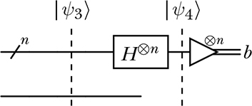
Step 3: Preprocessing & Measurement
The postprocessing after measurement is very complex for this problem in it is out of context to go through it in this course
The part of the circuit that will carry out the measurement process is given below:

Slide 16
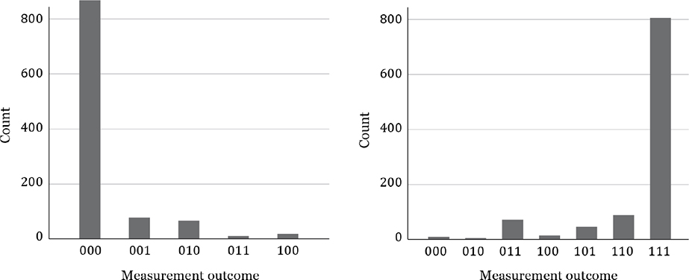
The Results
The results of the process are shown in the histograms below

